Slide 1
AVL Tree
By Mostafa Saad

Slide 2
AVL Balance Factor
15
10
20
Bf = 0
7
12
Bf = -2
16
13
Bf = -1
Bf = left height – right height
14
Bf = 0

Slide 3
AVL Balance Factor
15
Bf = 1
10
20
Bf = -1
7
12
Bf = 0
16
13
14
Bf = 0
Bf = 0

Slide 4
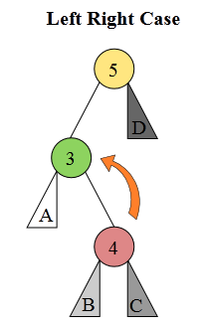
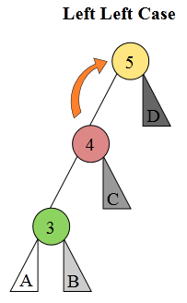
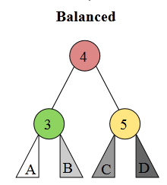
LR => LL => B
Left Rotation
Right Rotation
Imagine that: A, B, C, D are possible 4 sub-trees
We would like to do rotations to balance the 3 nodes causing a problem
But keep the BST property correct
You may think: A = 2, B = 3.5, C = 4.5, D = 6
Notes:
Image Src: http://upload.wikimedia.org/wikipedia/commons/f/f5/AVL_Tree_Rebalancing.svg

Slide 5
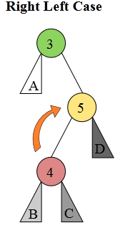
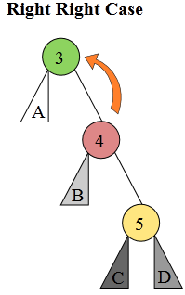
RL => RR => B
Right Rotation
Left Rotation
If you checked to the A, B, C, D order in the 3 shapes, you will find them sorted
Notes:
Image Src: http://upload.wikimedia.org/wikipedia/commons/f/f5/AVL_Tree_Rebalancing.svg

Slide 6
The general flow
  1- Add the element to the BST in normal way
  2- Let current node = just added one
  3- Calculate BF
  4- if |BF| > 1, we have an AVL unbalance
    If we are in case (3 or 4), convert to case (1 or 2)
    If new in case 1 or 2, handle them
  Let current node = parent
  Go to 3

Slide 7
Delete
Same steps as in BST
Start from where the node deleted (according to the 3 cases) and behave as the insertion in AVL( calc BF and do rotations if |BF| > 1)

Slide 8
Let’s simulate a big example
Build following AVL tree for input
3 5 9 1 0 2 6 10 7 4 8
Notes:
Input rearranged from an AVL lecture from CodeMasry Channel
Channel input: 100 120 140 80 60 90 130 145 135 110 137
Thanks for them

Slide 9
3 [5 9 1 0 2 6 10 7 4 8]
3
Bf = 0

Slide 10
3 5 [9 1 0 2 6 10 7 4 8]
3
Bf = -1
5
Bf = 0

Slide 11
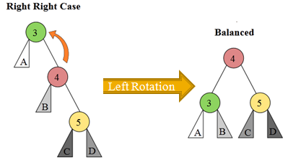
3 5 9 [1 0 2 6 10 7 4 8]
3
Bf = -2
5
Bf = -1
9
Bf = 0

Slide 12
3 5 9 [1 0 2 6 10 7 4 8]
5
Bf = 0
Bf = 0
3
9
Bf = 0

Slide 13
3 5 9 1 [0 2 6 10 7 4 8]
5
Bf = 1
Bf = 1
3
9
Bf = 0
1
Bf = 0

Slide 14
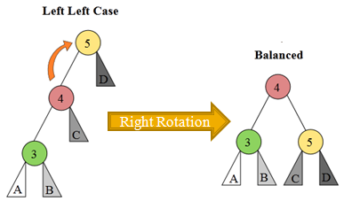
3 5 9 1 0 [2 6 10 7 4 8]
5
Bf = 2
3
9
Bf = 1
1
0
Bf = 0

Slide 15
3 5 9 1 0 [2 6 10 7 4 8]
5
Bf = 1
Bf = 0
1
9
Bf = 0
Bf = 0
0
3
Bf = 0

Slide 16
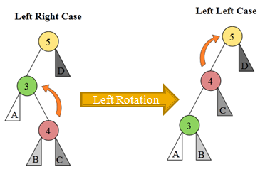
3 5 9 1 0 2 [6 10 7 4 8]
5
Bf = 2
Bf = -1
1
9
Bf = 0
Bf = 1
Bf = 0
0
3
2
Bf = 0
A = 0
B = 2
C = NULL
D = 9

Slide 17
3 5 9 1 0 2 [6 10 7 4 8]
Bf = -2
5
Bf = -1
3
9
Bf = 0
1
0
2
Bf = 0
Bf = 0
A=0
B = 2
C = NA
D = 9

Slide 18
3 5 9 1 0 2 [6 10 7 4 8]
Bf = 0
3
5
Bf = -1
Bf = 0
1
9
0
2
Bf = 0
Bf = 0
Bf = 0

Slide 19
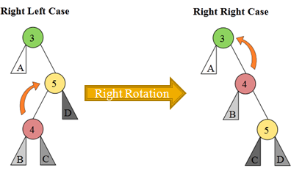
3 5 9 1 0 2 6 [10 7 4 8]
Bf = 0
3
5
Bf = -2
Bf = 0
1
9
0
2
Bf = 0 - (-1) = 1
Bf = 0
Bf = 0
6
Bf = 0

Slide 20
3 5 9 1 0 2 6 [10 7 4 8]
3
5
Bf = -2
1
6
Bf = -1
0
2
9
Bf = 0

Slide 21
3 5 9 1 0 2 6 [10 7 4 8]
Bf = 0
3
6
Bf = 0
Bf = 0
1
2
5
9
0
Bf = 0
Bf = 0
Bf =0
Bf = 0

Slide 22
3 5 9 1 0 2 6 10 [7 4 8]
Bf = -1
3
6
Bf = -1
1
2
5
9
0
Bf = 0
Bf = -1
10
Bf = 0

Slide 23
3 5 9 1 0 2 6 10 7 [4 8]
Bf = -1
3
6
Bf = -1
1
2
5
9
Bf = 0
0
Bf = 0
7
10
Bf = 0
Bf = 0

Slide 24
3 5 9 1 0 2 6 10 7 4 [8]
Bf = -1
3
6
Bf = 0
1
Bf =1
2
5
9
Bf = 0
0
4
7
10
Bf = 0
Bf = 0
Bf = 0

Slide 25
3 5 9 1 0 2 6 10 7 4 8
3
Bf = -2
A
6
Bf = -1
1
B
5
9
Bf = 1
0
2
4
7
10
Bf = -1
Bf = 0
8
C
Bf = 0
D

Slide 26
3 5 9 1 0 2 6 10 7 4 8
6
3
9
A
B
1
5
7
10
0
2
4
D
8
C

Slide 27
Implementation
The AVL is very easy in implementation
Same insertion as in BST
Insertion recursion backtrack = go up in flow
We could update height after insertion
Then calc the BF, if |BF| > 1 => balance
Just one last notice on rotation

Slide 28
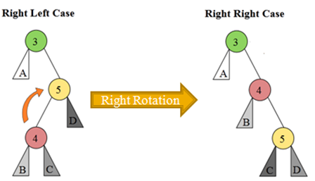
Rotation Implementation
++ at root 5
Rotate root = 5
Same Rotation behavior
One code
-+ at root 3
Rotate Right Branch = 5

Slide 29
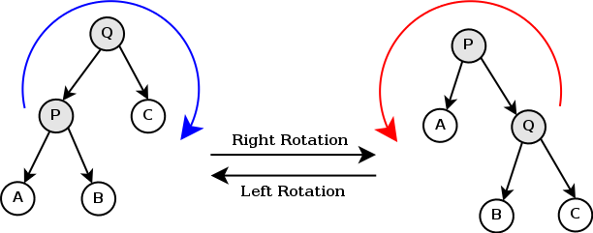
Rotation General Rule

